Slide 1
Tic-Tac-Toe Game

Slide 2
Project Title: Tic-Tac-Toe Game
Submitted By: Mahadev Kurwade
Course/Subject: OPEN Elective
Submitted To: Wankhede Mam
Date: 29/09/2024

Slide 3
Table of Contents 1. Introduction 2. Objective 3. Scope 4. Features 5. System Requirements 6. Technologies Used 7. Design and Architecture 8. Implementation 9. Testing 10. Result and Output 11. Conclusion 12. Future Enhancements 13. References

Slide 4
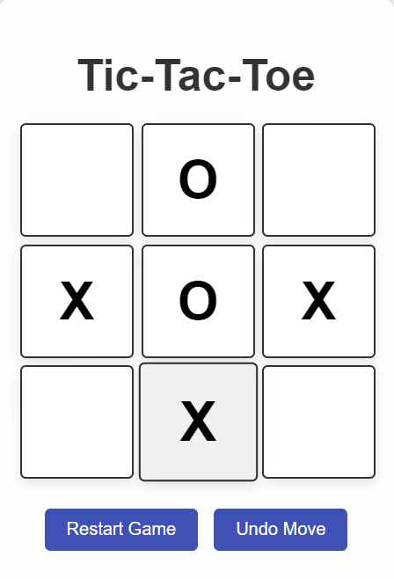
Introduction
Overview: The Tic-Tac-Toe Game project is an interactive web-based application that lets two players play the classic tic-tac-toe game. The objective is for players to mark X or O in a 3x3 grid until one player aligns three consecutive marks horizontally, vertically, or diagonally. Purpose: To create an engaging game with a simple user interface that can be played on both desktops and mobile devices

Slide 5
Objective
To develop a functional and visually appealing tic-tac-toe game using HTML, CSS, and JavaScript.
To implement dynamic gameplay features, such as highlighting the winner and providing an option to reset the game.
Scope
This project serves as a basic web-based game that can be played on any device with a browser.
Can be expanded to include features such as tracking scores, game history, and multiplayer support.

Slide 6
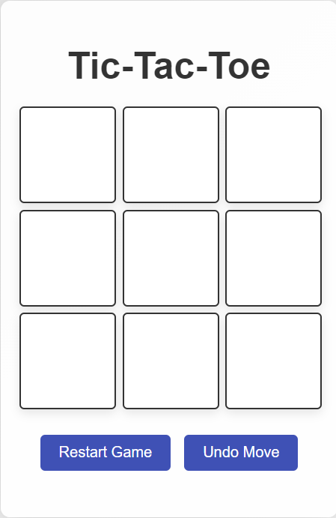
Features
Two-Player Gameplay: Players take turns placing X and O marks on the grid.
Winner Detection: The game highlights the winning sequence when a player wins.
Reset Function: Players can reset the game to start a new round.
Undo Option: Allows players to undo their last move.
Celebratory Animation: Displays a pop-up or animation for the winning player.

Slide 7
System Requirements
Software:
Operating System: Any (Windows/Linux/MacOS)
Web Browser: Chrome, Firefox, Edge, or Safari
IDE: Visual Studio Code, Sublime Text, or any preferred code editor
System Requirements
Hardware:
Processor: Any processor (e.g., Intel Core i3 or higher)
RAM: 2 GB minimum
Storage: 50 MB free space

Slide 8
Technologies Used
HTML: Structure for the game’s grid and buttons.
CSS: Styling for the game’s layout, buttons, and animations.
JavaScript: Logic for player turns, win condition checks, undo functionality, and animations.

Slide 9
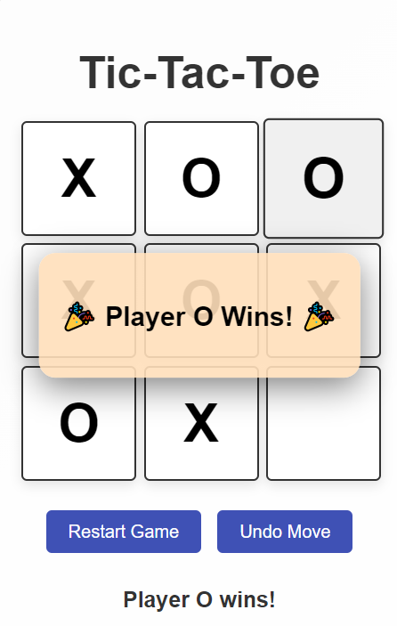
Design and Architecture
User Interface (UI): A simple 3x3 grid with clickable cells, a reset button, and a display for showing the current player's turn and winning status.
Game Flow Diagram: Diagram showing how each player interacts with the game, including state changes after each move.
Design Considerations:
Responsive Design: Ensures the game works on both desktop and mobile devices.
User Accessibility: Large, clickable grid cells make it easier for users to interact with the game.

Slide 10
Implementation
HTML Structure: Explanation of the HTML layout, including the grid and control elements (e.g., reset button).
CSS Styling: Styling code used for the layout, color themes, animations, and hover effects.
JavaScript Functions:
Function to handle players’ turns.
Function to check win conditions by rows, columns, and diagonals.
Function to reset the board.
Function for the undo feature to revert to the last move.
Animation and celebration effect functions to enhance the gameplay experience.
Code Snippets: Include significant portions of code, such as the win-check logic, undo functionality, and reset mechanism.

Slide 11
Testing
Testing Methodology: Briefly describe how the game was tested, focusing on testing gameplay functionality, responsiveness, and animations.
Test Cases: List key test cases, for example:
Test Case: Clicking a cell toggles X/O → Expected Outcome: Displays correct symbol and switches player.
Test Case: Three-in-a-row detection → Expected Outcome: Highlights winning cells.
Test Case: Resetting the board → Expected Outcome: Clears the grid and resets to initial state.
Result: Document any issues and their resolutions, as well as screenshots from successful test cases.

Slide 12
Result and Output
Screenshots: Include screenshots of:
Initial game board.
Mid-game play with Xs and Os on the board.
Winning sequence with the celebration or pop-up effect.
Performance: Mention how the game performs on different devices, highlighting its responsiveness and visual effects.

Slide 13
Conclusion
Summarize the project, focusing on the successful implementation of game mechanics and user interactions.
Mention any goals achieved, such as the creation of a user-friendly interface and responsive gameplay.
Future Enhancements
Suggestions for future improvements:
Adding an AI opponent for single-player mode.
Keeping track of scores across multiple games.
Adding sound effects and enhanced animations.
Allowing players to set their names and save their scores.

Slide 14
References
Include any sources referenced during the project, such as guides, documentation, and tutorials.
Example:
JavaScript Documentation
CSS Animation Guide
HTML5 Game Development

Slide 15
Thank you
Mahadev Kurwade
Kurwademahadev@gmail.com

